Slide 1
EXERCISES

Slide 2

Did you understand anything???

Slide 3
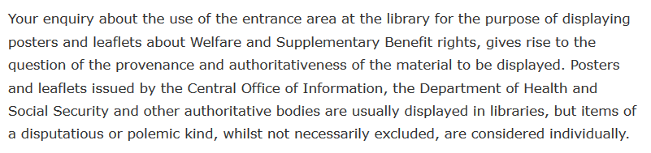
Did you understand anything???

Slide 4
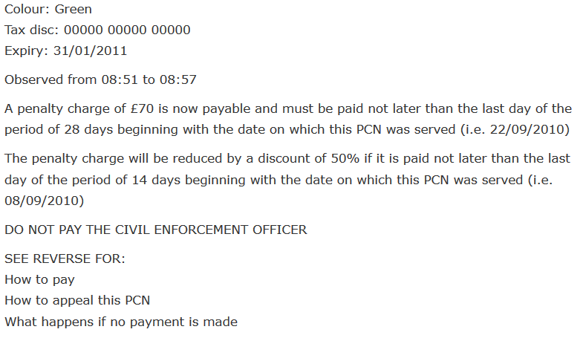

Slide 5
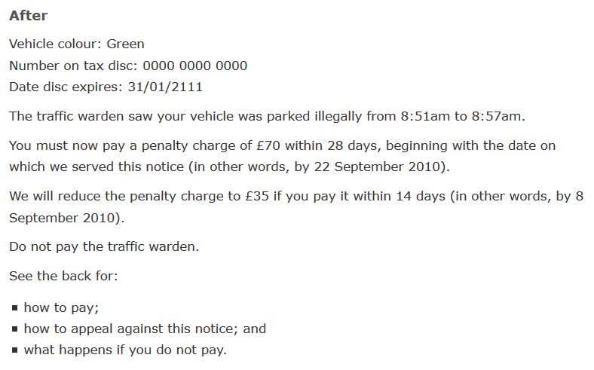

Slide 6
Compare the definition of “Plagiarism by MIT and HEC-PK
MIT
Plagiarism occurs when you use another’s words, ideas, assertions, data, or figures and do not acknowledge that you have done so.
If you use the words, ideas, or phrasing of another person or from published material, you must
Use quotation marks around the words and cite the source, or
Paraphrase or summarize acceptably and cite the source.
If you use charts, graphs, data sets, or numerical information obtained from another person or from published material, you must also cite the source.
HEC-PK
“Verbatim copying, near-verbatim copying, or purposely paraphrasing portions of another author's paper or unpublished report without citing the exact reference.
Copying elements of another author's paper, such as equations or illustrations that are not common knowledge, or copying or purposely paraphrasing sentences without citing the source.
Verbatim copying portions of another author's paper or from reports by citing but not clearly differentiating what text has been copied (e.g. not applying quotation marks correctly) and /or not citing the source correctly” [1].

